Slide 1
Furniture Sales Forecast
Mini Project 4
Submitted by:
Sumit

Slide 2

Problem Statement
Find out the popularity of a certain product and how its sales can impact the business.
In order to achieve this goal, a predictive model can be built to find out the sales and future forecast of the furniture sales.
What are the key factors that can help to increase the sales and profit of furniture's.

Slide 3

Methodology
Read the data.
Summarize the data.
Data structure (Type of data).
Data Visualization.
Check for stationarity.
Selecting right algorithm for model building.

Slide 4
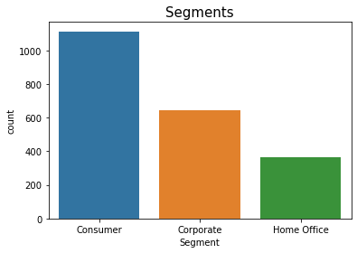
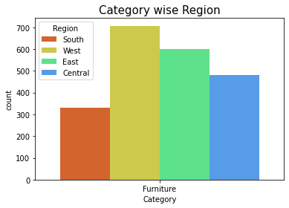
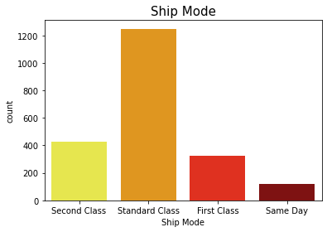
EDA(Exploratory data analysis)
In furniture category Consumer segment has more than other segments.
West region is more than others regions.
Ship mode is max. at standard class.

Slide 5
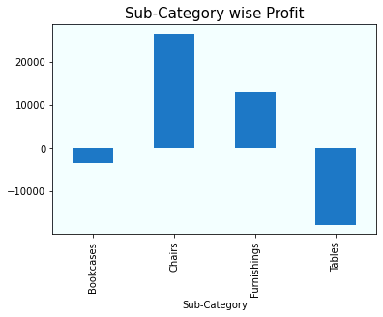
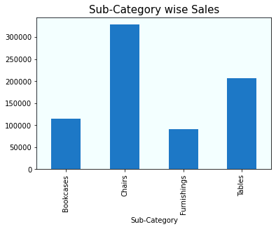
Category wise sales and profit
In furniture sub-category chairs has the max. sales and profit then other sub-category.

Slide 6
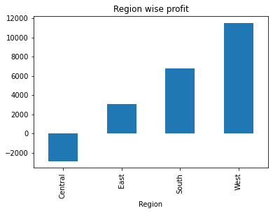
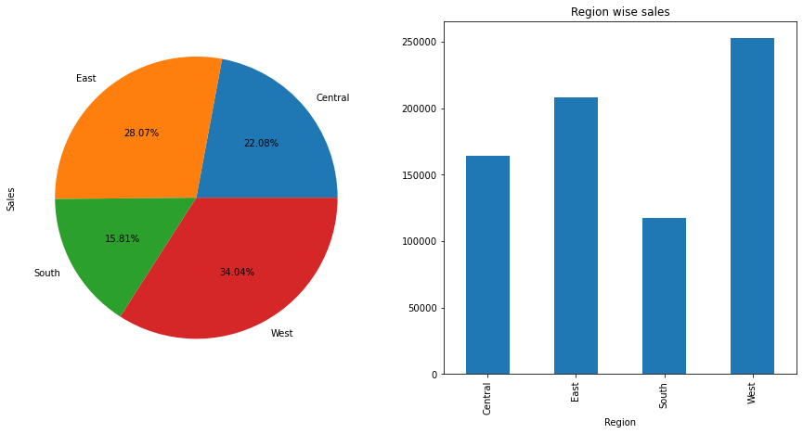
Region wise sales
Region wise sales
In Region wise sales and profit West region has the maximum no. of sales and profit.
Central region has the enough sales but its profit is in negative.

Slide 7
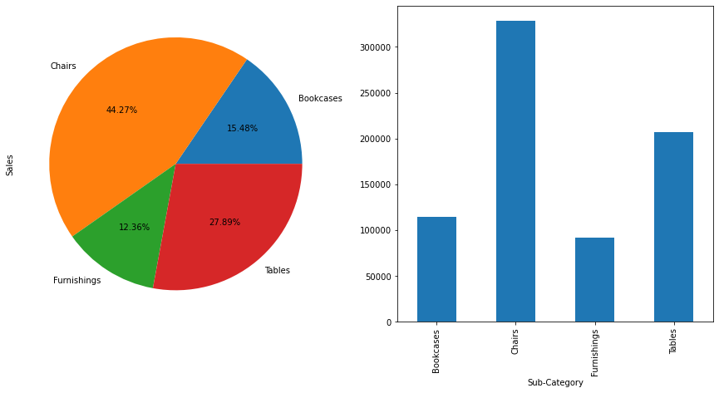
Sub-category wise sales
Sub-category wise sales
Sub-category wise sales
Chair sub-category has the max. no of sales and profit from the west region.

Slide 8
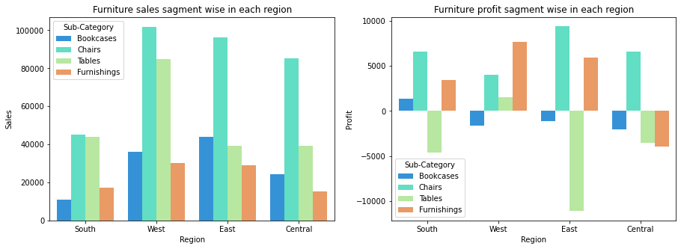
Furniture sales and profit segment wise in each region

Slide 9
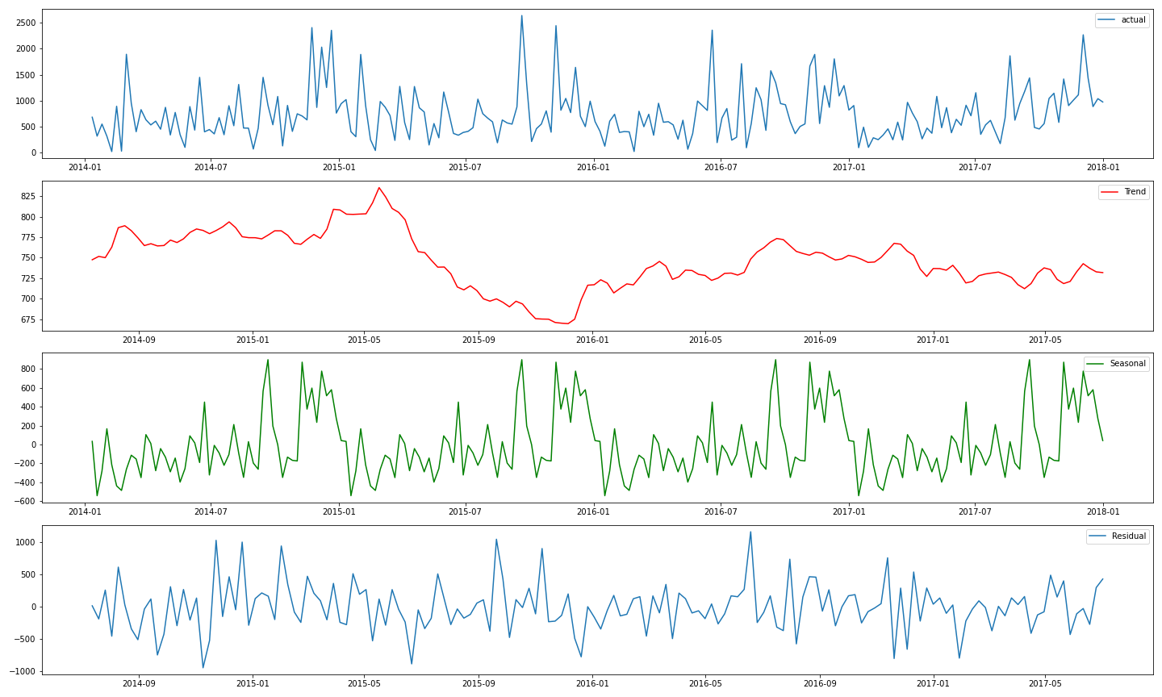

Trend/Seasonality
Actual Sales
Trend
Seasonality
Trend
As our data has both trend and seasonality in our data, so we will proceed with SARIMA and SARIMAX model.

Slide 10
Model results
SR No. | Model Name | AIC value | BIC value
1. | SARIMA | 1941 | 1941
2. | SARIMAX | 1902 | 1902
By comparing all Time series model we can go with SARIMAX model because its giving low AIC and BIC .

Slide 11
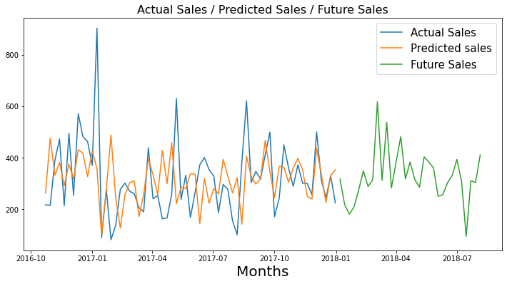
Forecast value(for SARIMAX model)
Here in SARIMAX model which show the future forecast values for furniture sales.

Slide 12
Conclusion
By comparing the Sarima and Sarimax model with AIC & BIC score we got Sarimax model is best fitted model. Its predict the best values for furniture sales and give best future forecasted values which may help to analysis the future sales.
In furniture we have maximum sales and profit of chairs from the west region but from the central region we have huge loss in tables.
So for getting high profit in furniture sales we have to minimize the loss of tables and try to get profit from the tables for this we need to focus on central region.
For improvement of profit we need to take feedback from the customers like what the regions we need to focus on it. So that we also get profit from the central region.

Slide 13


